Slide 1

Intruder System By Smart Eagle
Nguyen Cong Nhuan Phuc ( UDA)
Bùi Tiến Quốc (UDA)
Thân Anh Quân (UDA)
Naruaki Nemoto (SIT)
Willy Andreas (MCUT)

Slide 2

Illustration

Slide 3
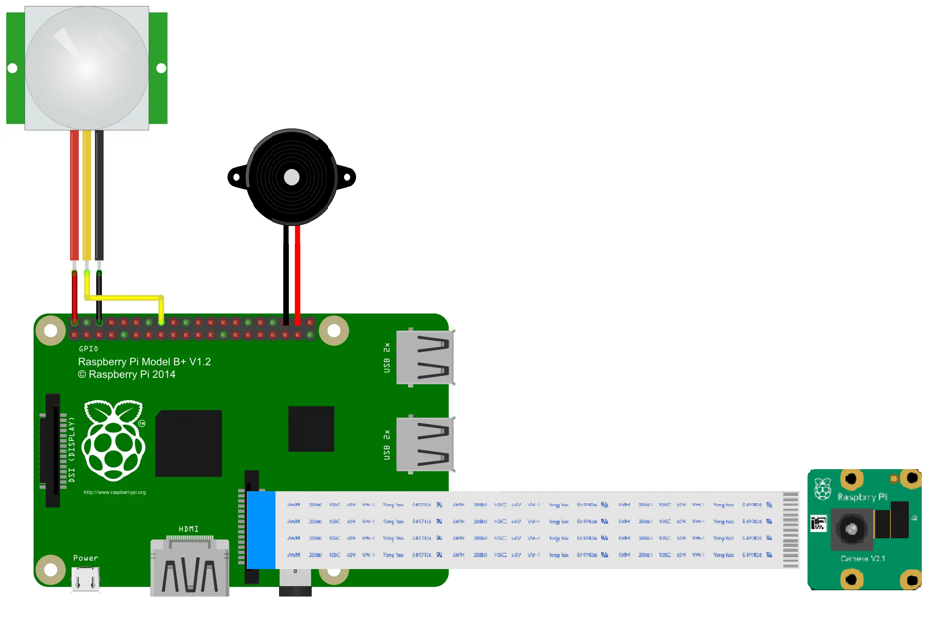


Proposed System
If intruder comes, PIR sensor gets triggered
Send picture & timestamp to Firebase
Camera active
Buzzer active
On/Off command
On/Off command
Send picture & timestamp to App

Slide 4
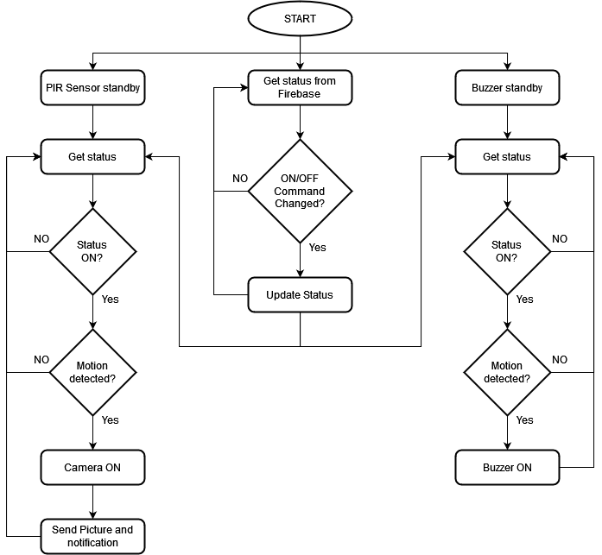
Process in Raspberry Pi
Cloud Storage
Firebase
PIR Motion Sensor
Buzzer
Camera
Raspberry Pi

Slide 5
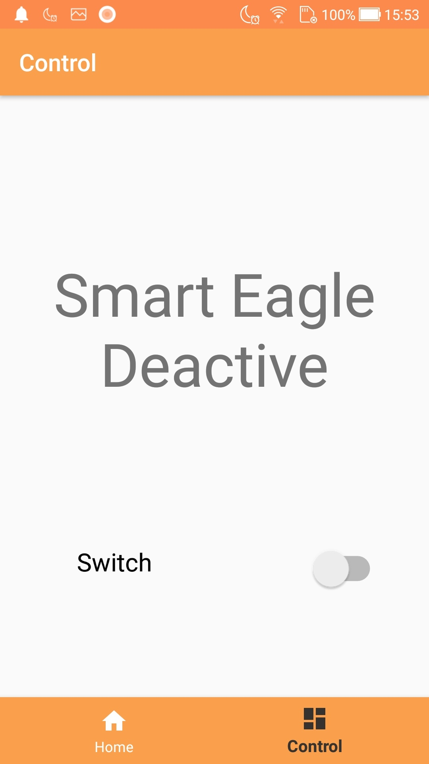
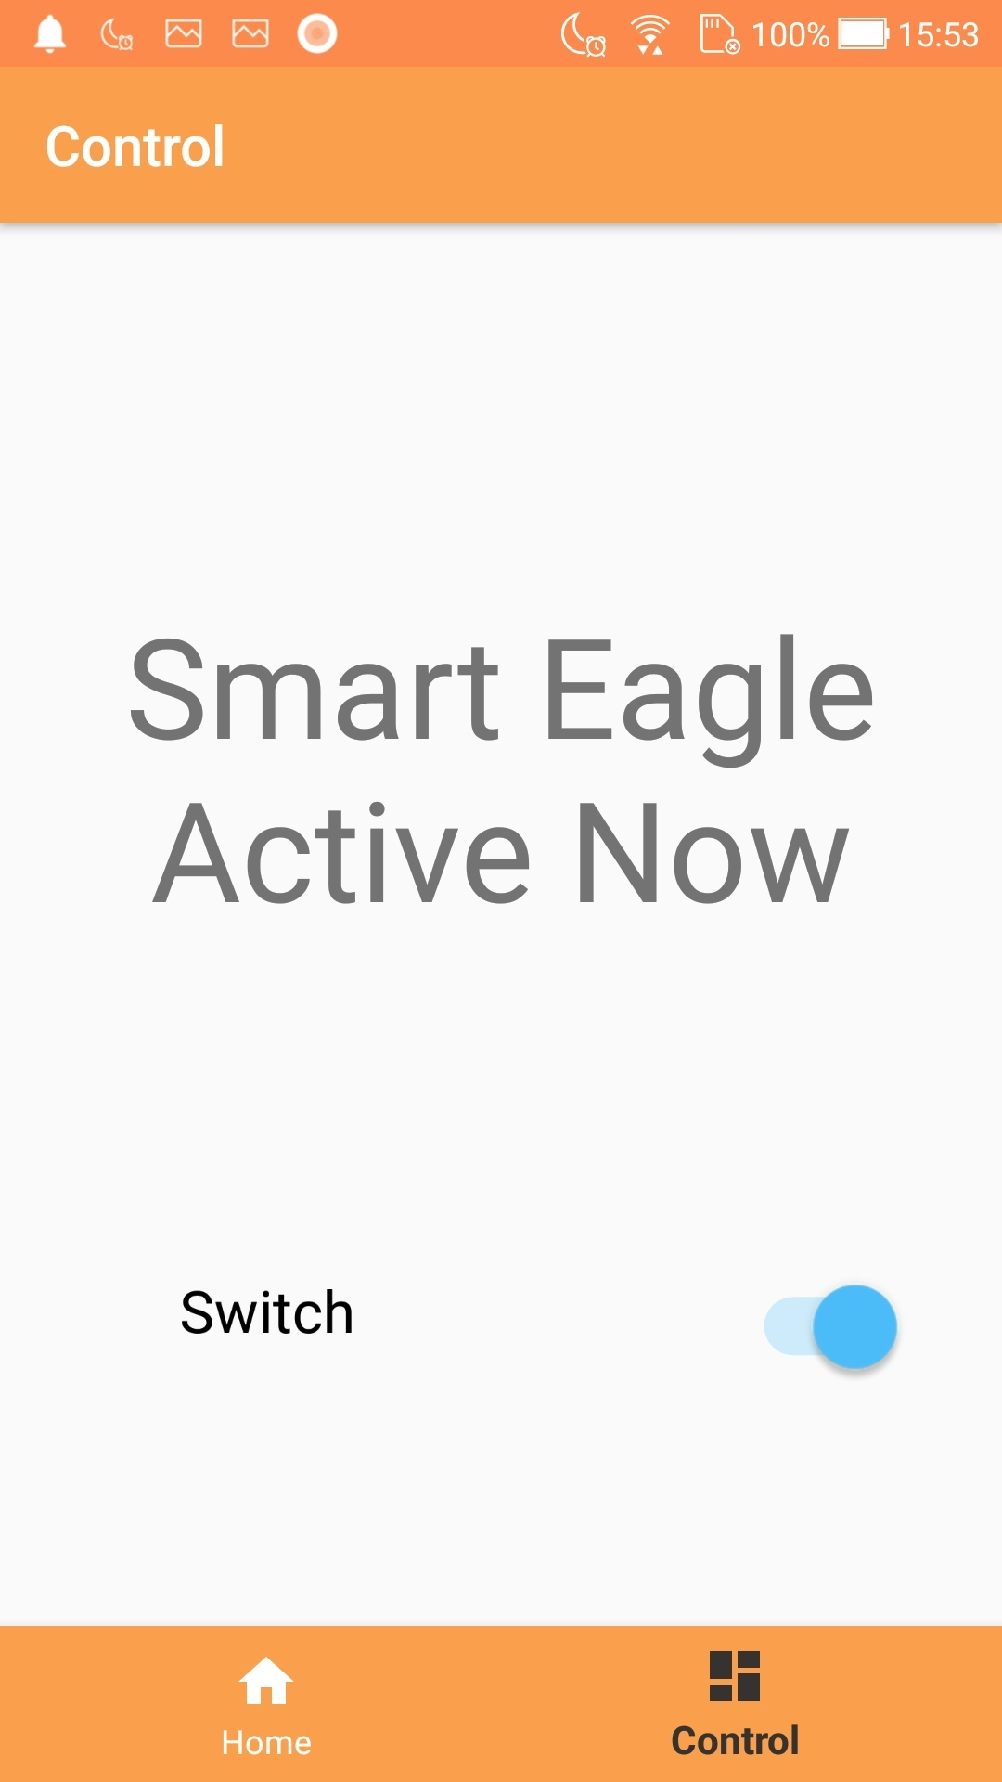
Process in Android App
Cloud Storage
Firebase
Send picture & timestamp
to client
Send picture & timestamp to cloud
On/Off
On/Off
Android App
Raspberry Pi
Client
Server
Notes:
-WEB APIs (In Java - Android device) Web APIs (Application Programming Interfaces) are interfaces that allow software applications to interact with each other over the internet, using a standardized set of protocols and tools.
Web APIs use HTTP (Hypertext Transfer Protocol) as the primary protocol for communication. This means that applications can send requests to a web API using HTTP methods such as GET, POST, PUT, and DELETE, and receive responses in a structured format such as JSON (JavaScript Object Notation) or XML (Extensible Markup Language).

Slide 6
Demonstration

Slide 7
Thank You 謝謝大家 Cảm ơn ありがとうございます

